Slide 1
How to use manaba
student orientation
Japanese Language Education Program

Slide 2
Login to manaba
Make sure you have ID and the password

Slide 3
Enter “manaba” into the search bar or click the tab “Current Students” on Hitotsubashi University homepage

Slide 4
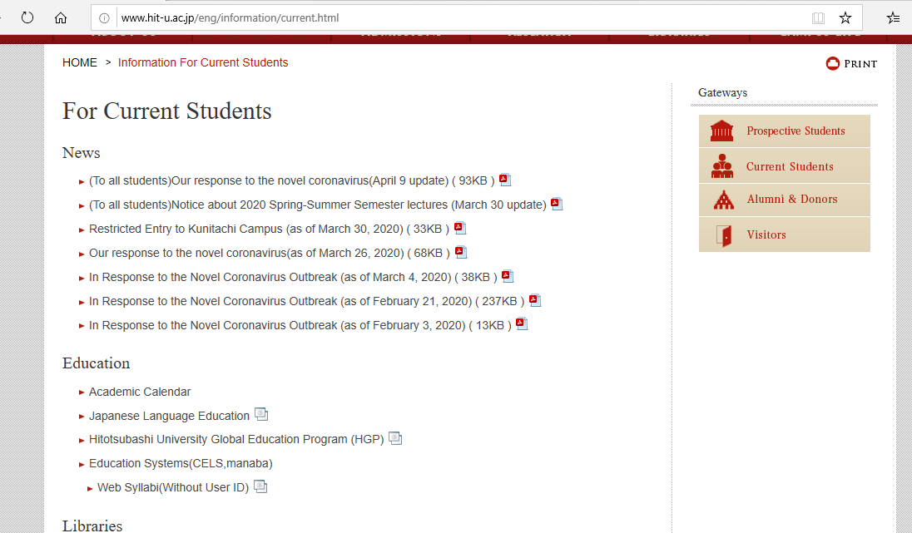
Click “Education Systems (CELS, manaba)”

Slide 6
Enter your Student ID and password

Slide 7
If you have already registered on CELS you will be automatically registered on manaba

Slide 8
Self-registration to the course
If you are still considering which course to take, please make a self-registration.
You can find important information on the course page
★ Zoom links (URL) for logging in to the
classes
★ announcements from the teachers

Slide 9
Click the button “English”

Slide 10
Click “Search and register for courses” in the box “About Self Registration”

Slide 11
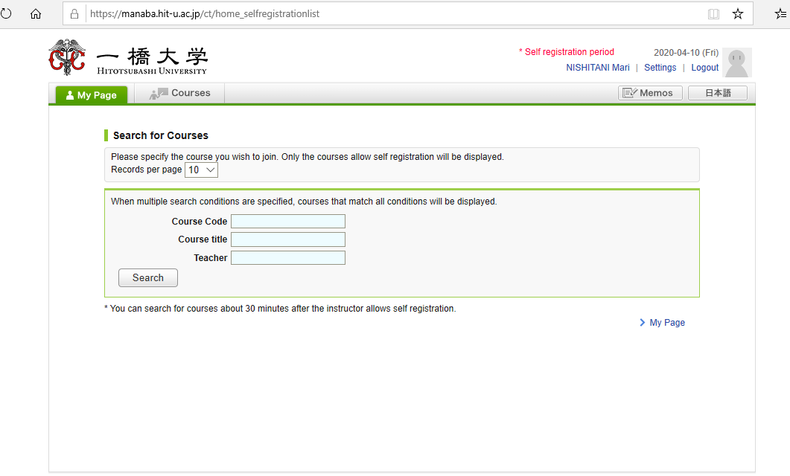
Enter the course title E.g. “Basic Japanese”

Slide 12
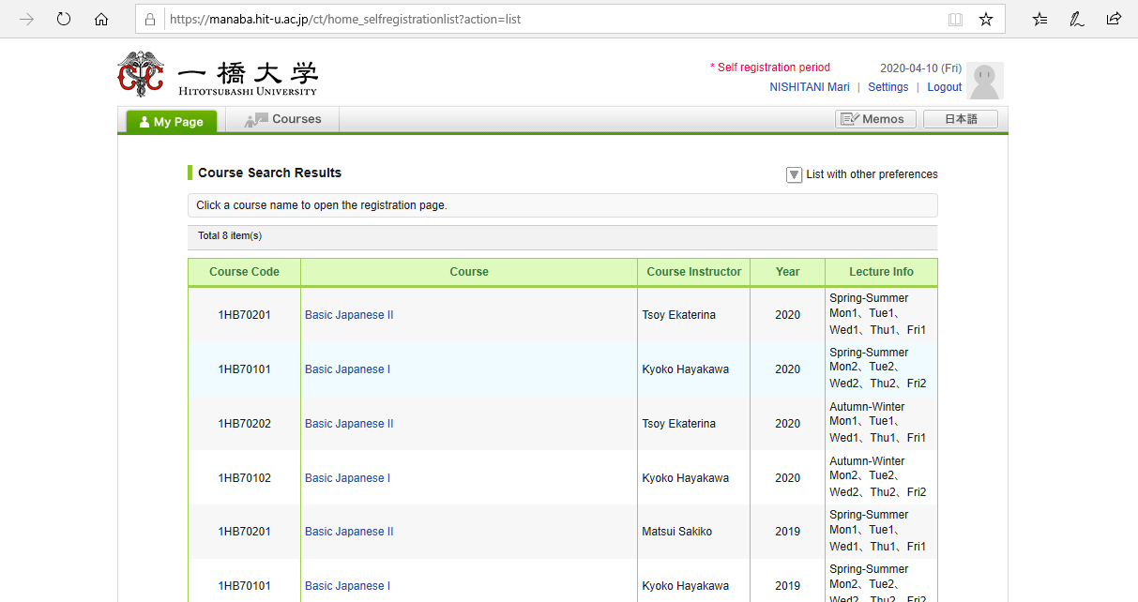
A list of courses will appear. Click “Basic Japanese I”

Slide 13
Click “Basic Japanese I”

Slide 14
After you click the button “Register”, the following message will be displayed. ”Self registration is complete. If you would like to finalize the registration, please do so using the Student Information System.”

Slide 15
When the self-registration is complete, the course will be added to “My Courses” list.

Slide 16
NOTE!
Self-registration on MANABA is different from the CELS course registration.
If you decide to enroll in the course as a regular student, you should complete the course registration procedure on CELS.

Slide 17
Receive manaba COURSE NEWS via mail
Teachers will post important news on manaba
★ Zoom links (URL) for logging in to the
classes
★ announcements from the teachers
Make sure to change reminder settings in order to receive announcements to your email.

Slide 18
Important announcements

Slide 19
Click “Settings”

Slide 20
Click “Change reminder settings”

Slide 21
① In the field “All reminders” select “Receive”. ② Fill in your regular Email address （and the cellphone Email address） that you want reminders to be sent to. Please use the email address you check daily.
Click

Slide 22
① Click “save and sent test mail” at the bottom of the screen. ② You will receive the following message:
This email was generated automatically by manaba to confirm
if you have set up a correct email address.”

