Slide 1


THE UNIVERSITY OF WORLD ECONOMY AND DIPLOMACY (UWED)

Slide 2

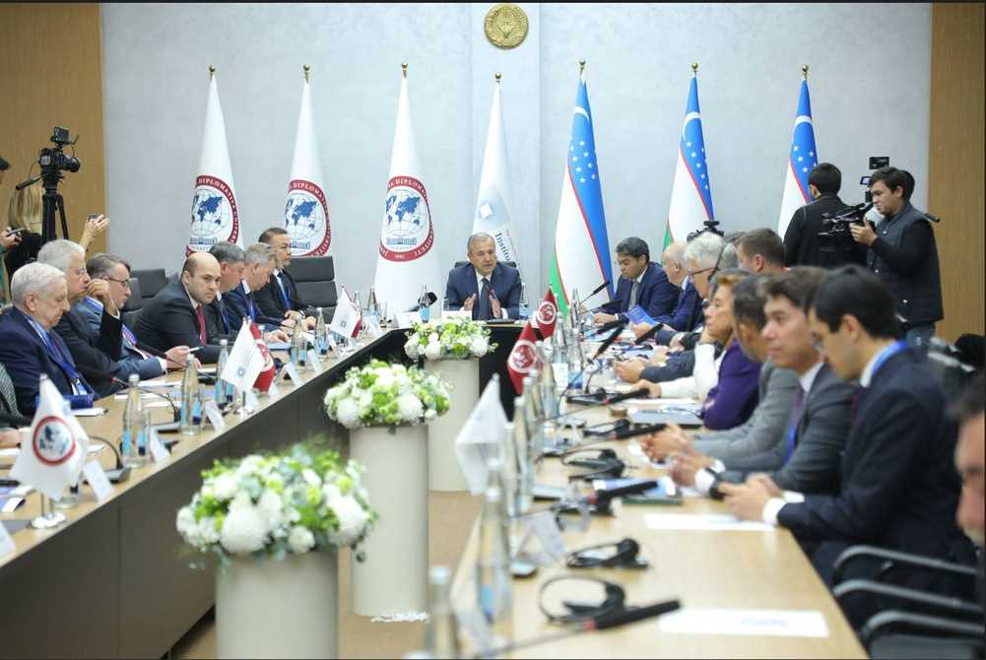


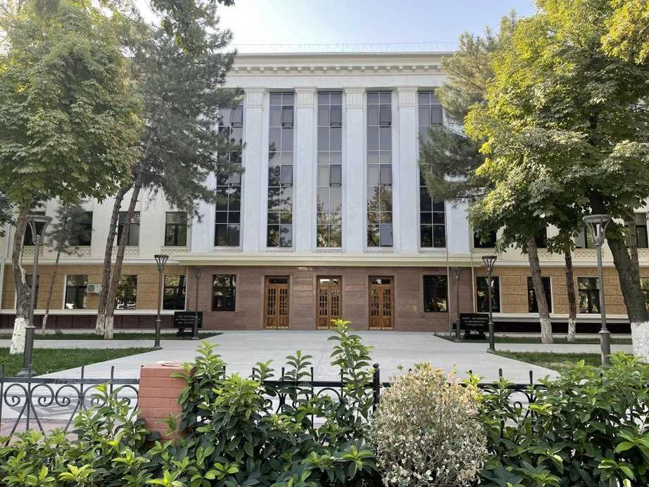

About UWED
The University of World Economy and Diplomacy (UWED) was established on September 23, 1992 and was included in the system of the Ministry of Foreign Affairs of the Republic of Uzbekistan
It is a basic higher educational institution that provides training, retraining and advanced training for specialists and scientific and pedagogical personnel, conducting high-level fundamental and scientific and applied research on international relations, political science, global economy, and law
UWED offers a comprehensive education system, including a four-year undergraduate degree program, a one-year master's degree program, and a doctorate in selected academic disciplines.

Slide 3




Academic programs
Departments
Language Training Center
International Relations Political Science Civil Law and Private International Law International Law and Public Law Sciences International Finance and Investments International Economy Systematic Analysis and Mathematical Modeling
Uzbek and Russian languages English language Romano-Germanic languages (German, French, Spanish, Italian, Turkish) Oriental Languages (Chinese, Korean, Japanese, Urdu and Arabic)
3 schools:
International Relations International Economy and Management International Law

Slide 4

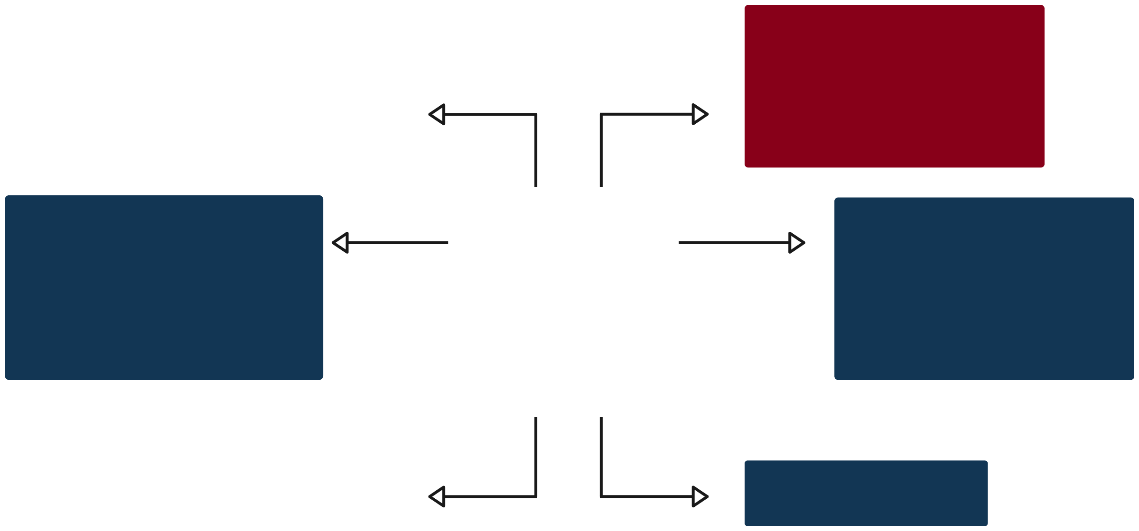


Courses offered by UWED
Political Management
Analysis of geostrategic risks
Conflict resolution (conflict studies)
AI in Politics
Administrative Law
Civil Law
Criminal Law
Public International Law
Financial and Tax Law
Soft power diplomacy
Techniques of political negotiations
Diplomatic and consular service
Strategic culture
Political anthropology
Intellectual Property Rights
International Organizations Law
World Trade Organization Law
International Investment Law
EU Law
Domestic politics and foreign policy
Energy geopolitics
System Analysis of Political Processes
Strategic Thinking and Interaction
Transnational corporations in international relations
Probability and Statistics
Green Economy
Econometrics
Financial Management
Development Economics
International Management

Slide 5
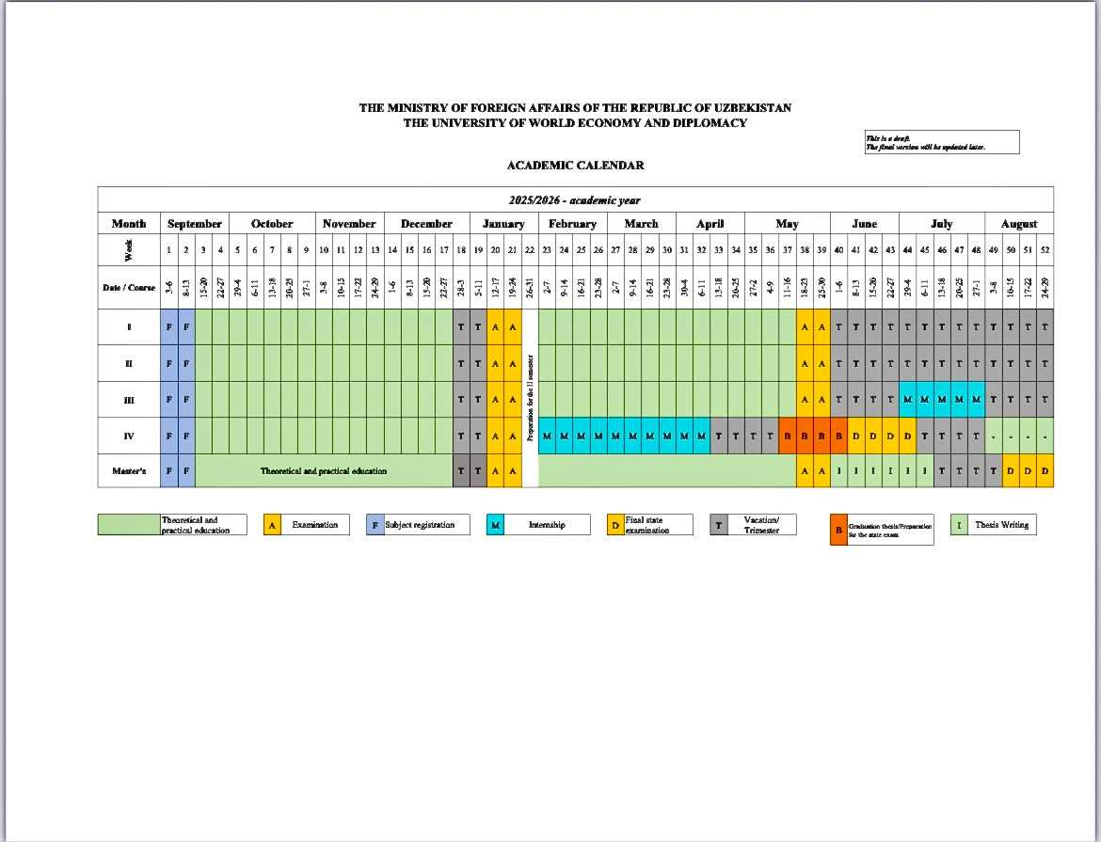
Academic calendar year 2025/2026

Slide 6





Necessary information
Academic year at UWED consists of Fall semester and Spring semester.
-Fall semester: September to December
-Spring semester: January to May
Holidays in Uzbekistan
January 1 – New Year’s Day
January 14 – Defenders of the Motherland Day
March 8 – International Women’s Day
March 21 – Navruz (Spring Festival)
May 9 – Day of Memory and Honor
Date varies – Ramadan Eid (Ramazon Hayit)
Date varies – Eid al-Adha (Qurbon Hayit)
September 1 – Independence Day
October 1 – Teachers and educators’ Day
October 21 – Uzbek Language Day
December 8 – Constitution Day
Grading system: based on a 100-point scale with ECTS-based learning system.
Usually 6 ECTS per one discipline
Visa Application Support
UWED provides assistance with the visa application process. However, students are required to cover the visa fee. The visa application and associated fees should be confirmed with the consular department of the Ministry of Foreign Affairs (MFA). The processing time for a visa is typically between 10-15 days. Students should ensure they have all the standard documents required for the visa application.

Slide 7
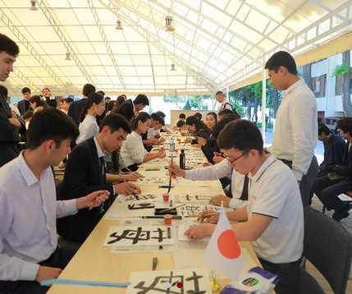
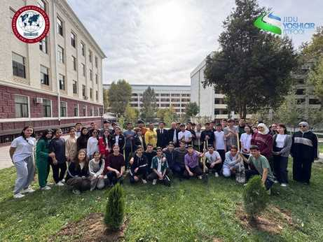
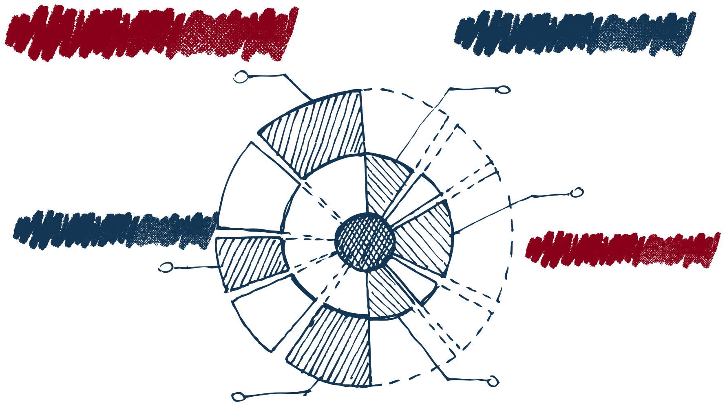

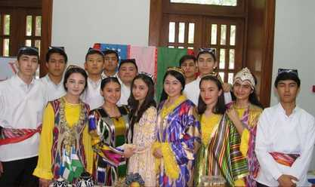
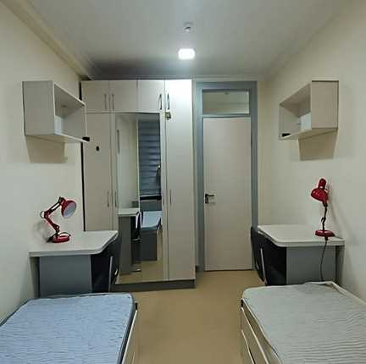

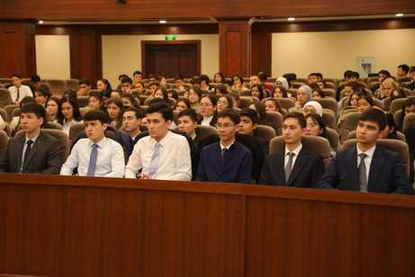
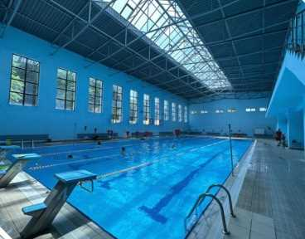


Campus life
YOUTH CREATIVITY CLUB
STUDENTS’COUNCIL COUNCIL
SPORT CLUBS
FESTIVALS
LIBRARY
DORMITORY

Slide 8


Why choose UWED?
Visa Support – Assistance with applications and legal procedures.
Uzbek & Russian Language Courses – Learn and immerse in local culture.
International Academic Cooperation Office Dedicated support for foreign students.
Buddy Program – Local student mentors to help you adjust.
Vibrant Campus Life – Cultural events, student clubs, and networking.
Affordable & Safe – Enjoy quality education in a welcoming environment.

Slide 9
Exchange student program
Important dates for Spring semester/Fall semester:
Nomination period – October 1- October 30/May 1 - May 30 (by your university)
Application period – November 15- November 30/ June 15 - June 30
(students submit their documents via email: CV, Motivation letter, Language certificate, passport, photo)

Slide 10
Exchange student program
BEFORE ARRIVAL:
UWED will send course list and information about university
Applying for visa
Applying for dormitory (if the rooms are available) or finding apartment
AFTER ARRIVAL:
At the AIRPORT, register your IMEI at customs. After that, you will need to complete the registration at https://uzimei.uz/.
Register your residence at the dormitory or apartment (a residence registration fee will be required).
Register for your courses.
Start of the semester.

Slide 11
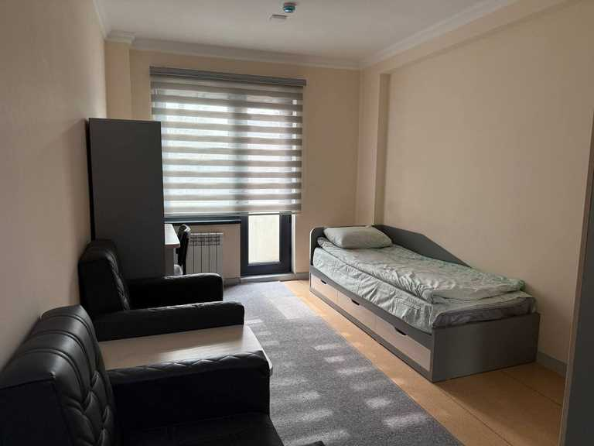
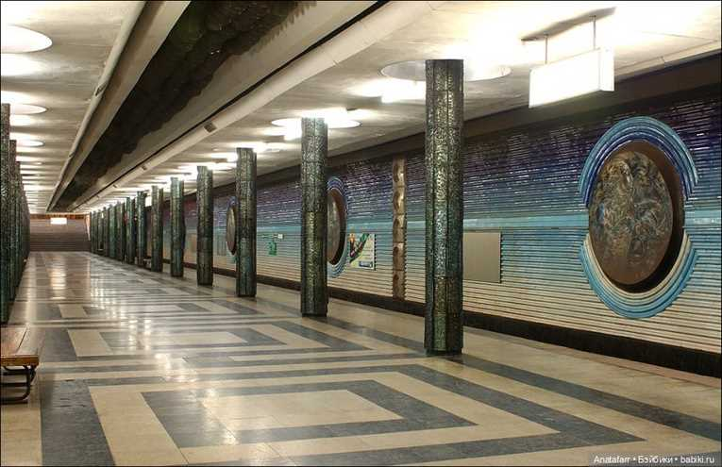

Accomodation and expenses
1)Dormitory: around $240 per month (single room)
2)Rent of apartment: $300-500
3)Transportation: $12 (public transport)
4)Food: $160-$320
Overall: $500-$700 per month
Note: Prices may vary depending on lifestyle. Dorms are available upon request (spaces are limited). Tashkent has well-developed public transport, taxis are available through Yandex Go and MyTaxi.

Slide 12
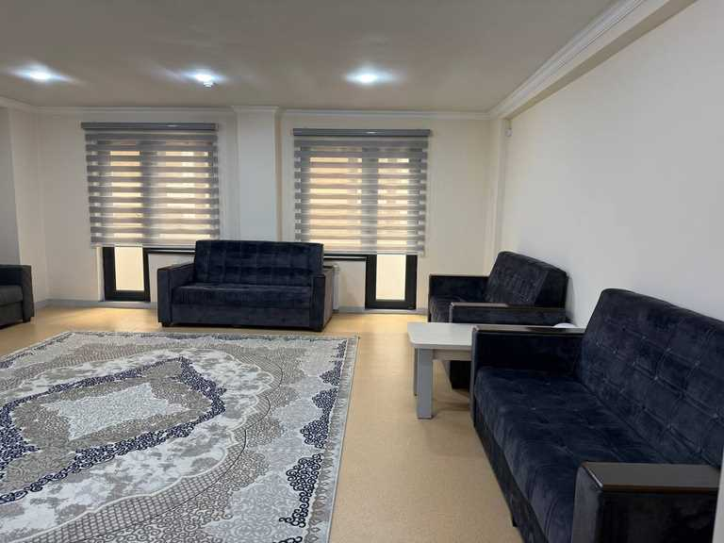
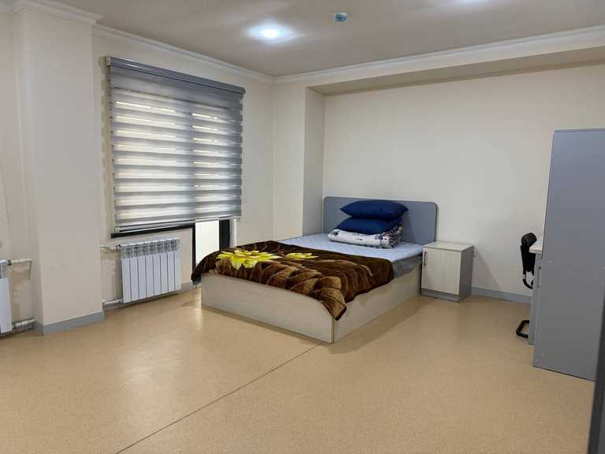
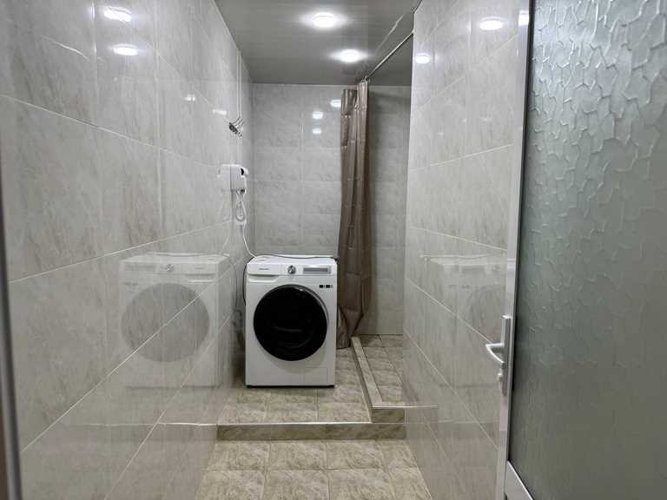
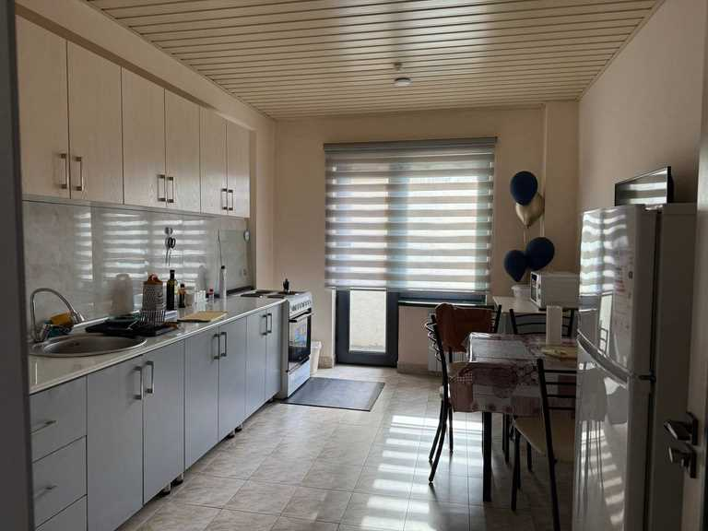
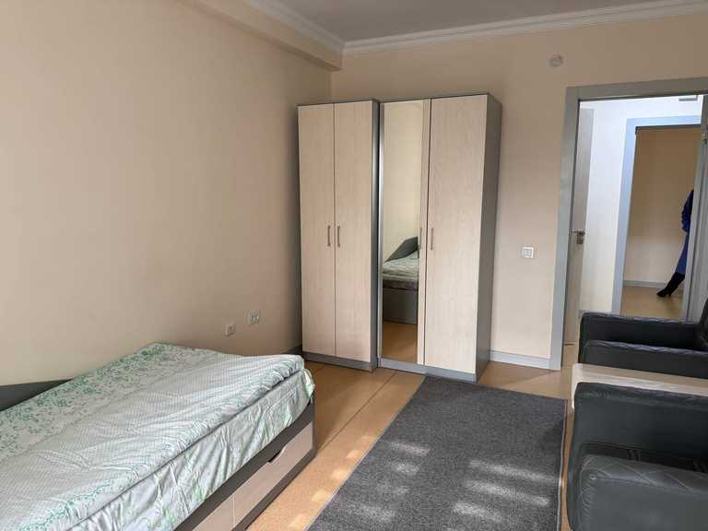
Dormitory at UWED

Slide 13
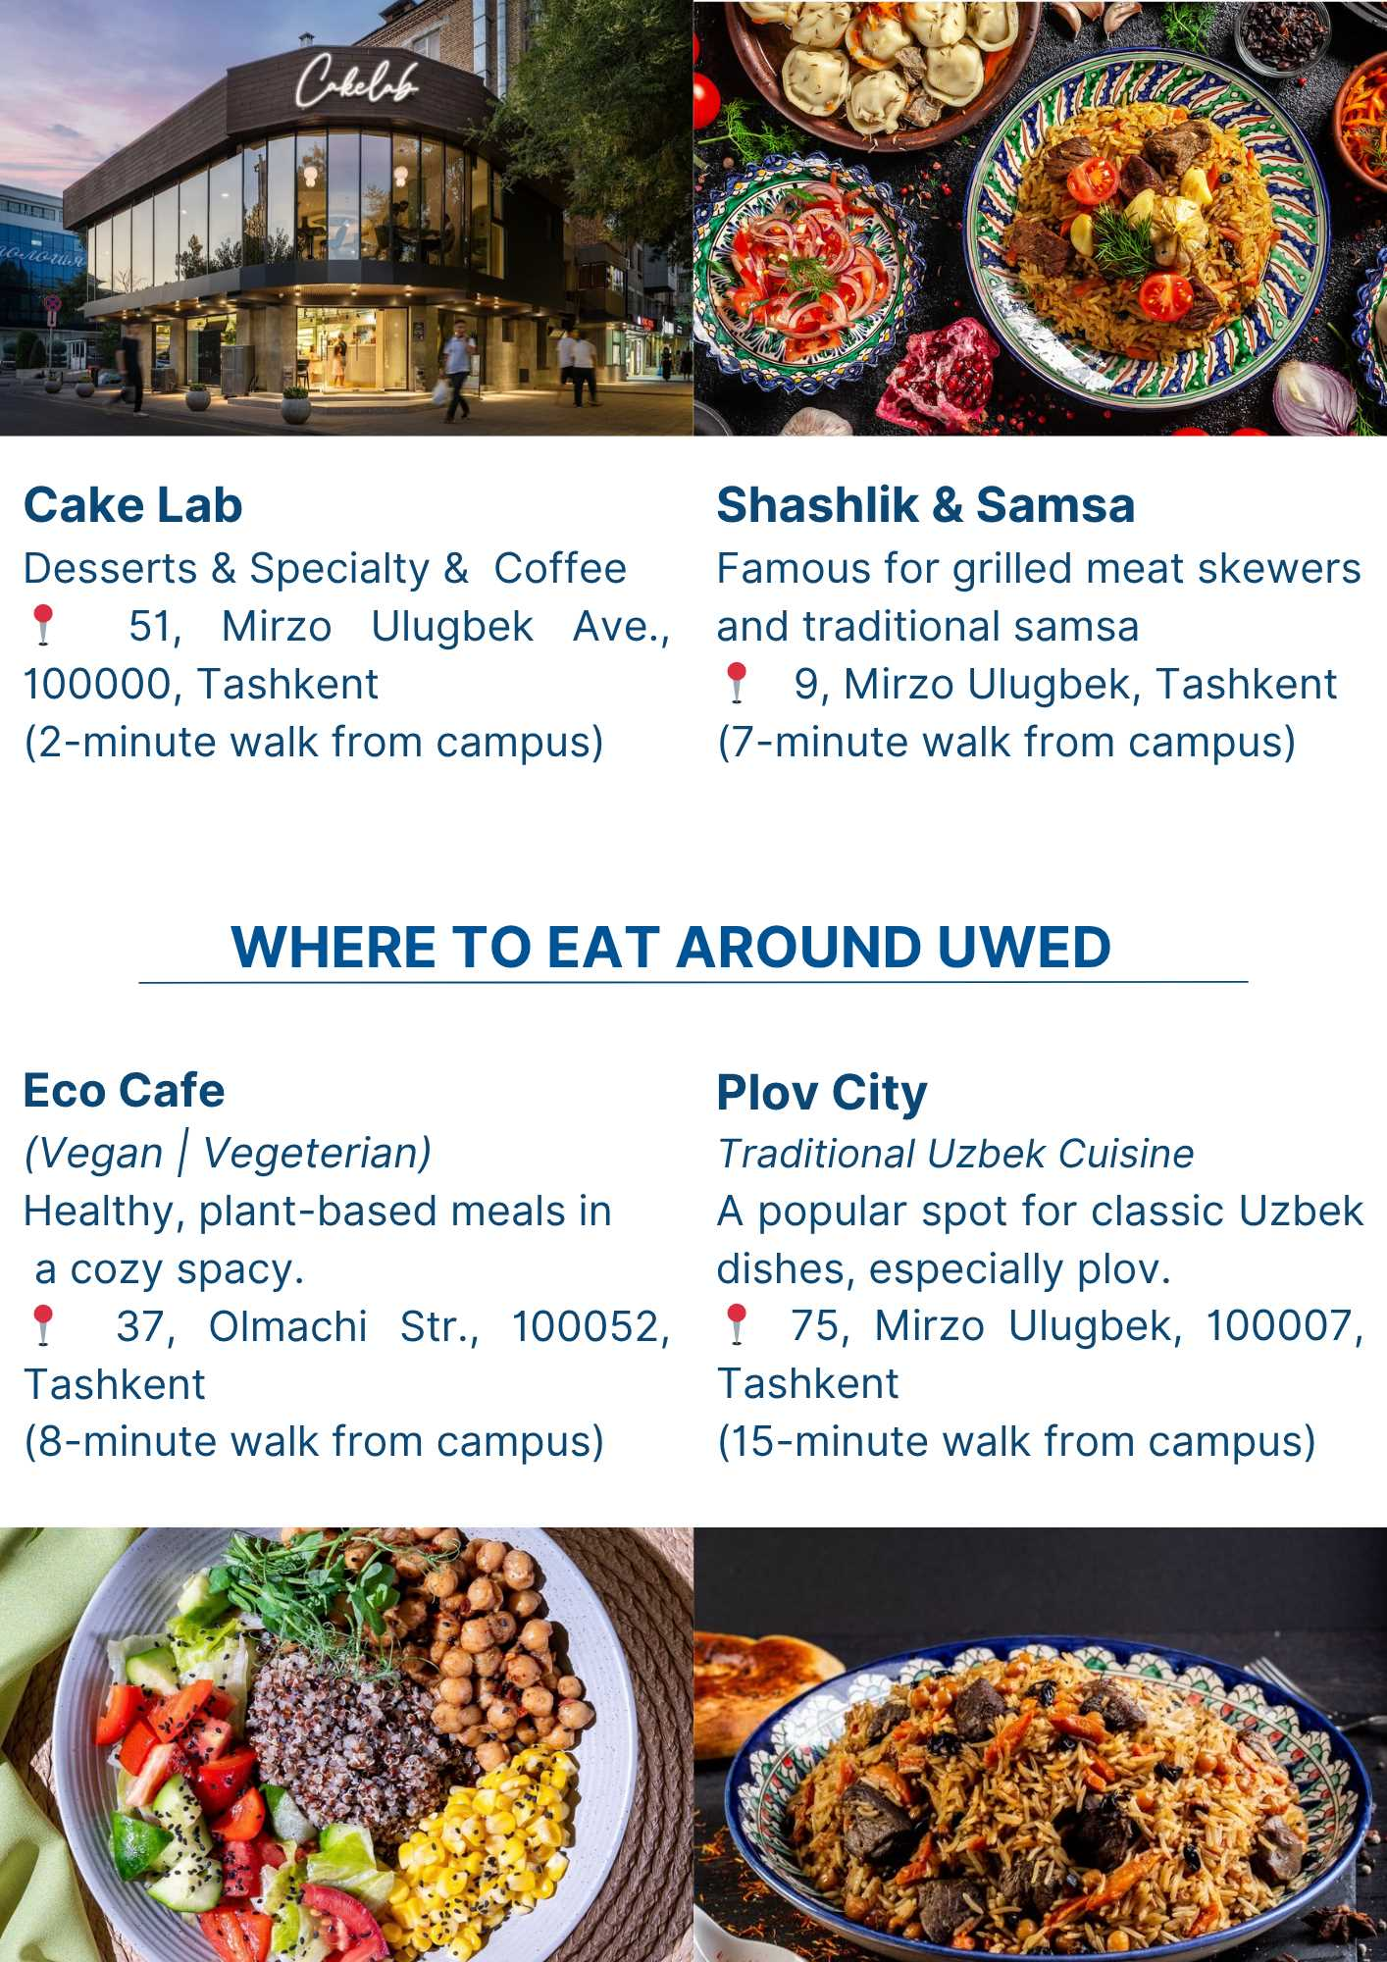
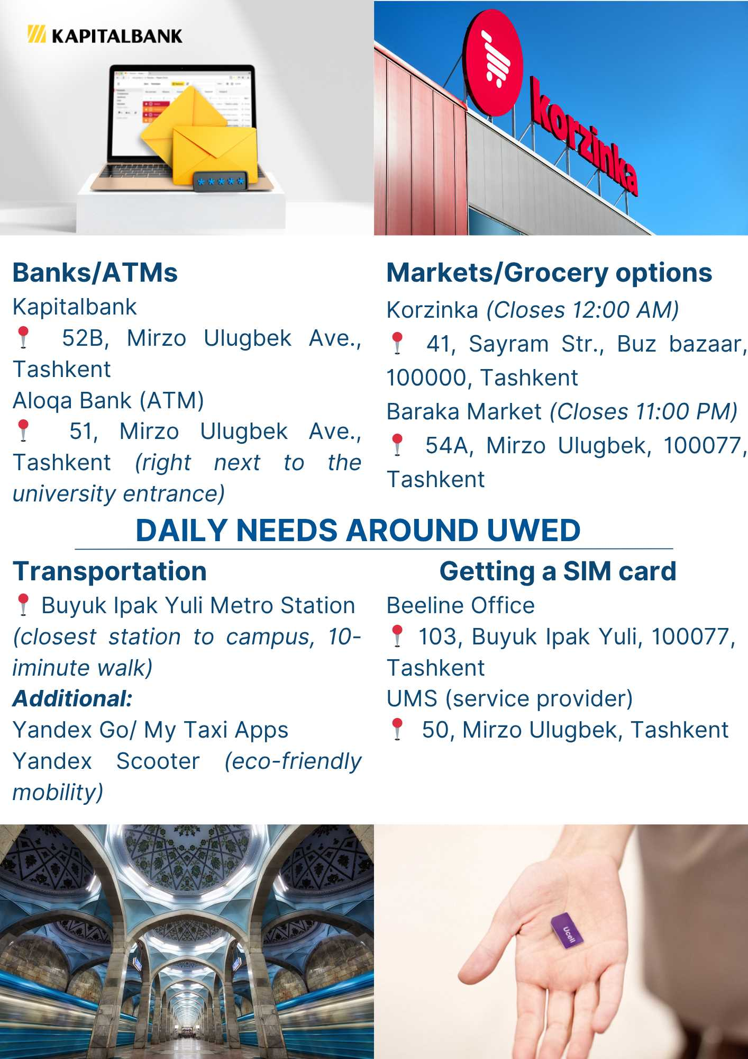

Slide 14
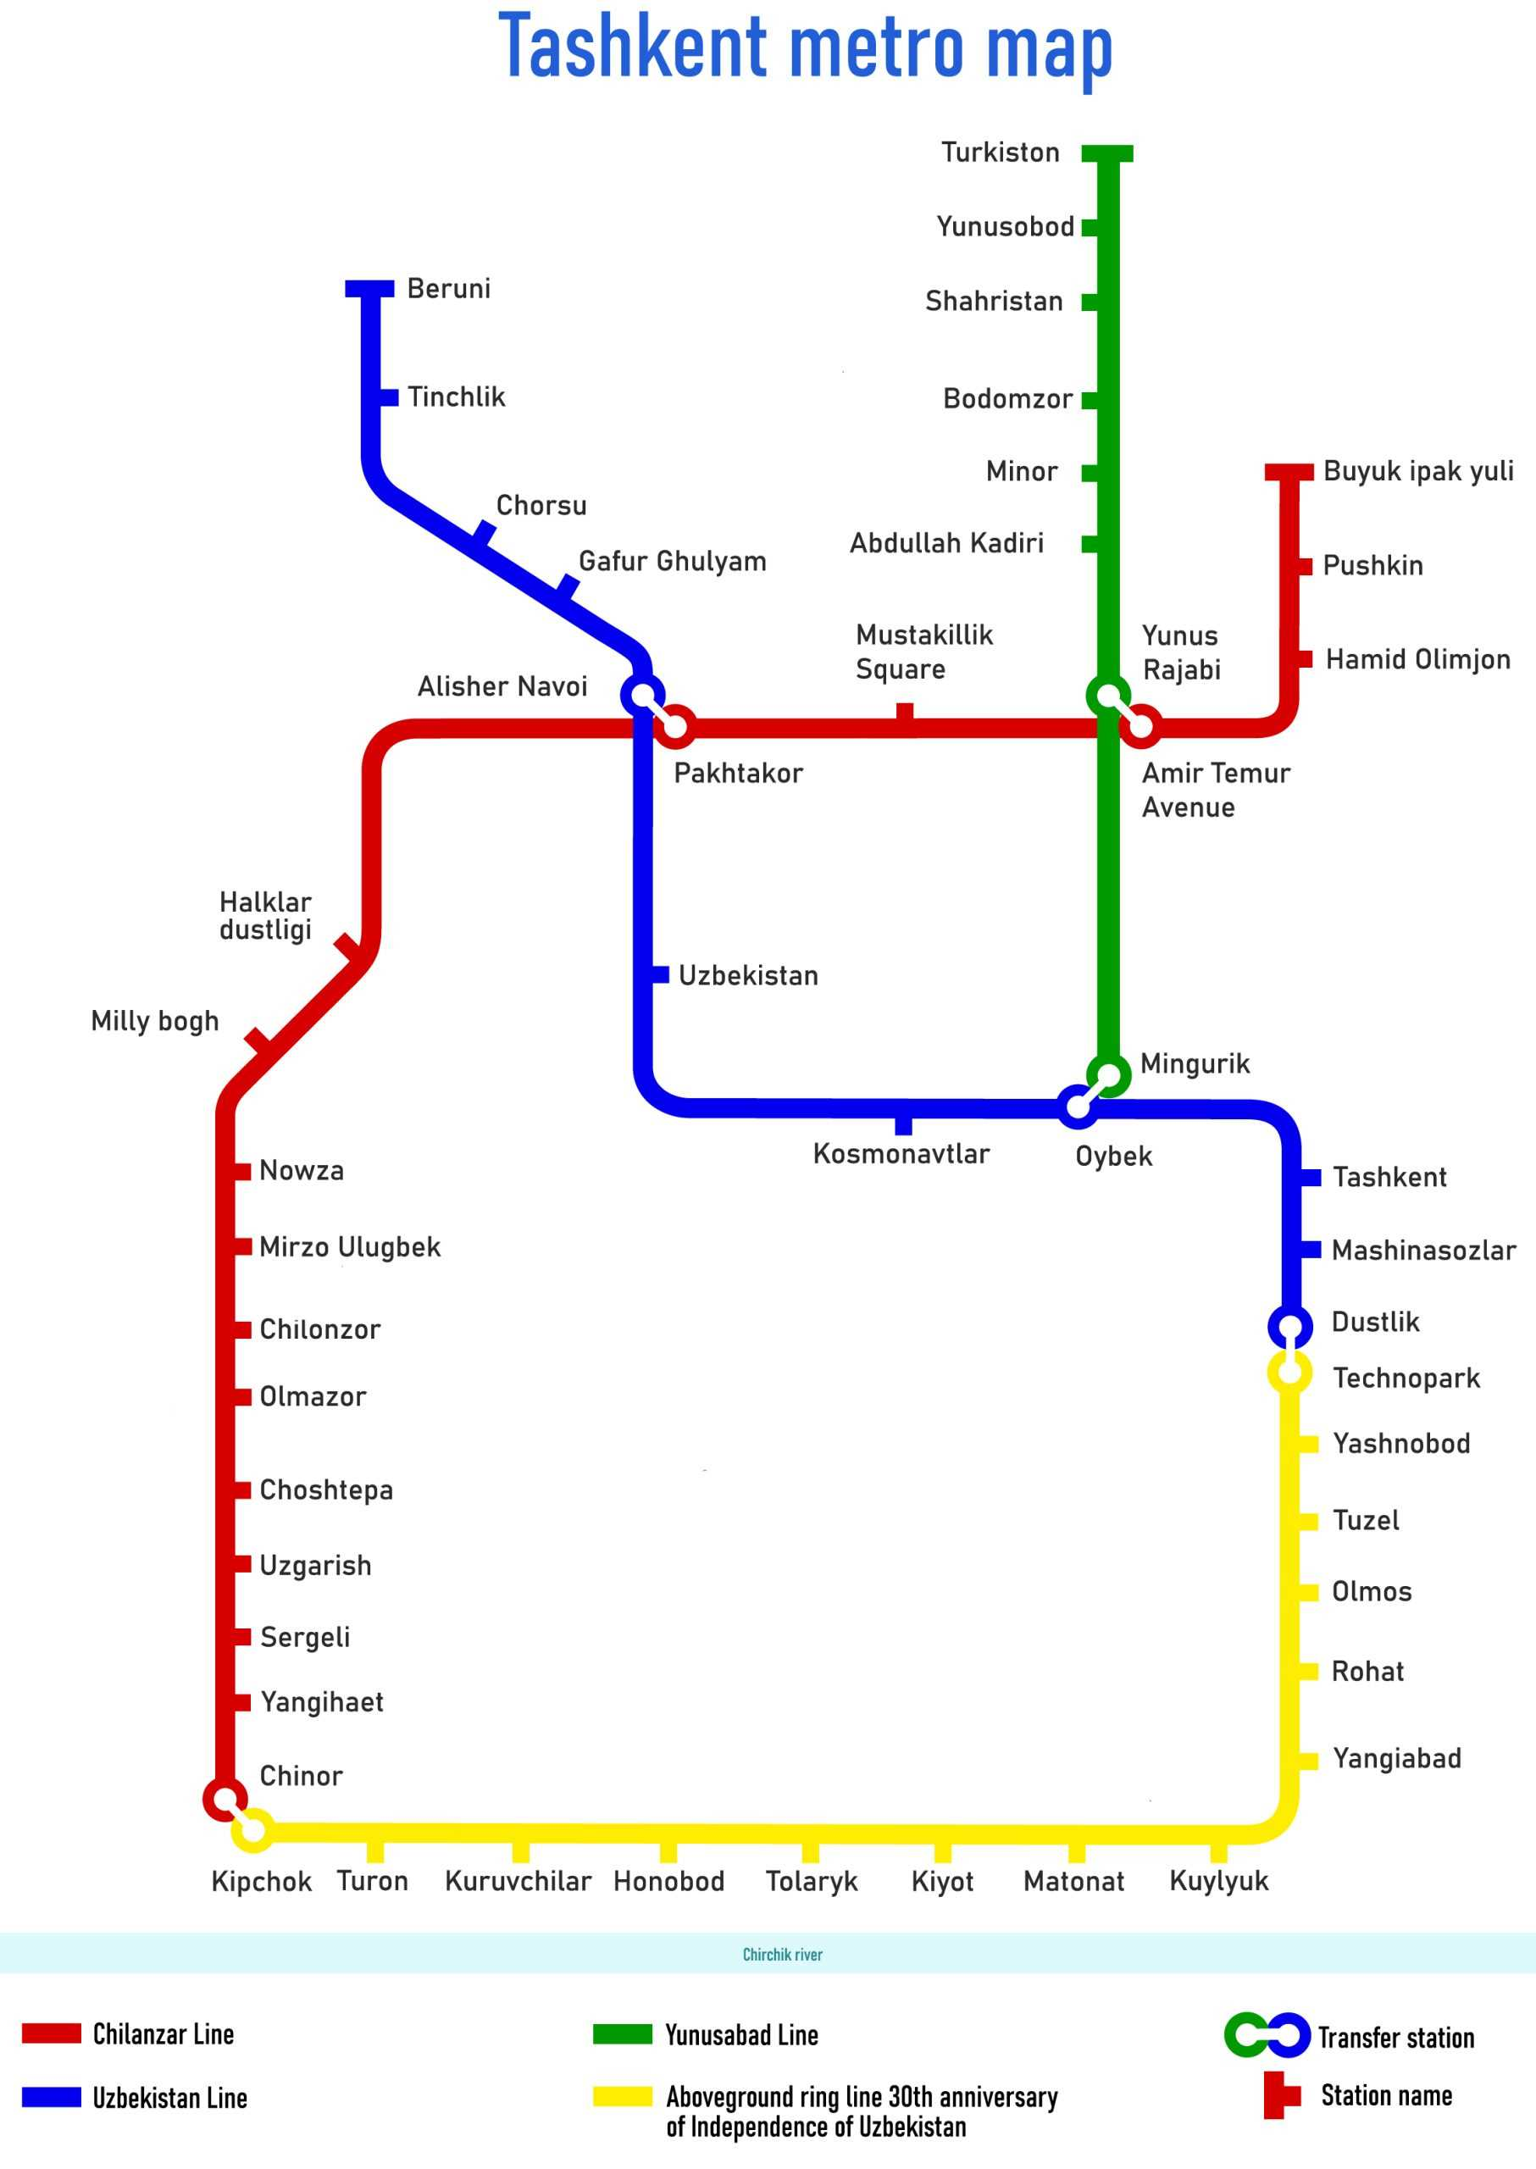
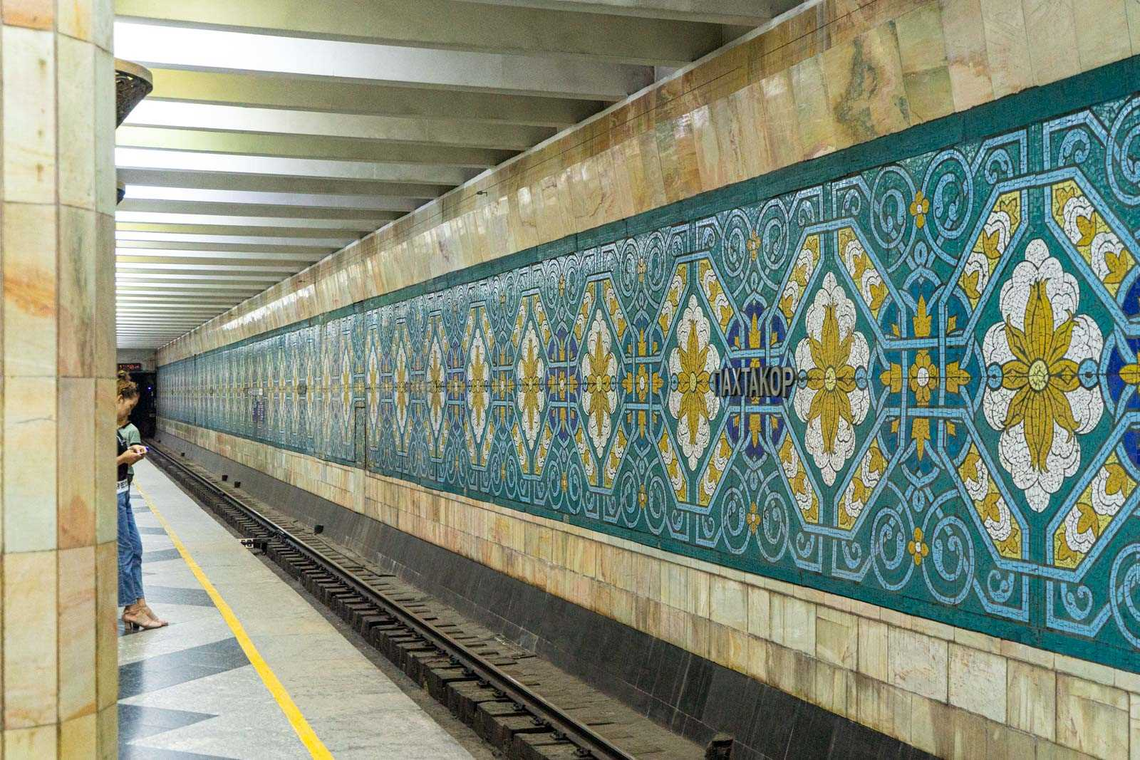

UWED

Slide 15
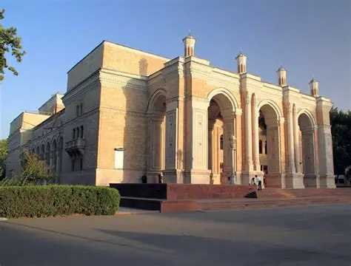
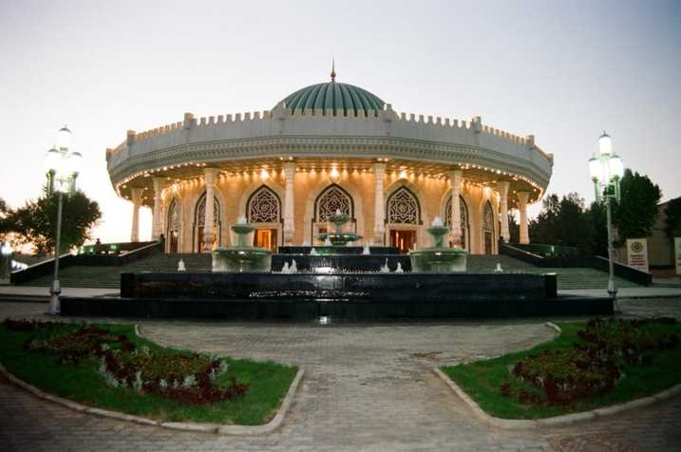
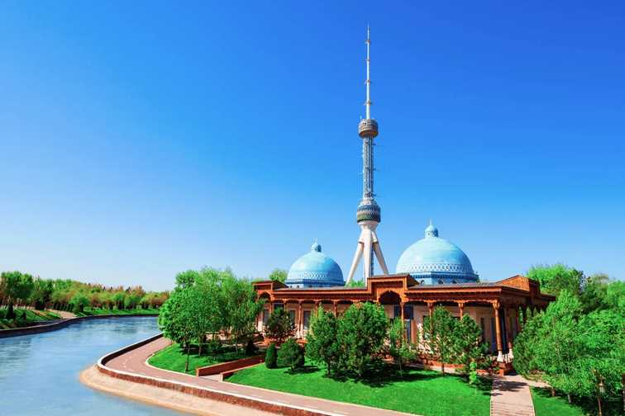
Places in Tashkent
Tashkent TV Tower
The State Museum of the Temurids History
Alisher Navoi Grand Theatre
For more information visit
https://uzbekistan.travel/en/c/attractions/

Slide 16



Places in Tashkent
For more information visit
https://uzbekistan.travel/en/c/attractions/
Seoul Mun
Tashkent City
Magic City

Slide 17
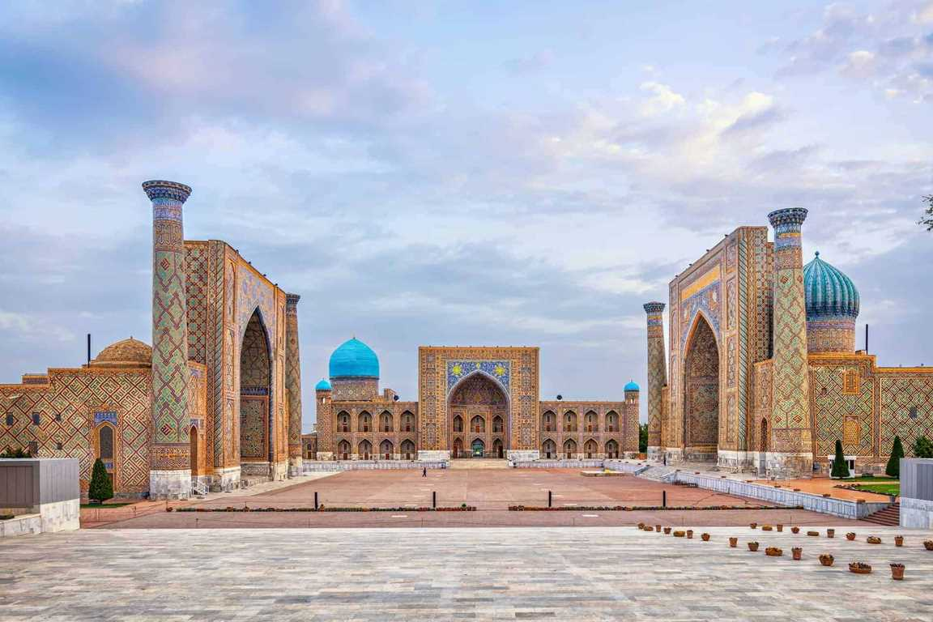
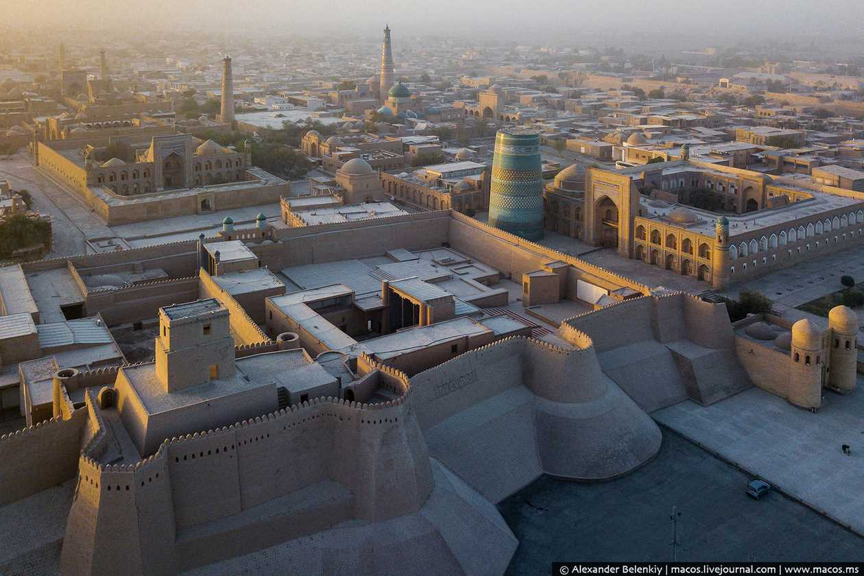
Cities in Uzbekistan
SAMARKAND
KHIVA

Slide 18
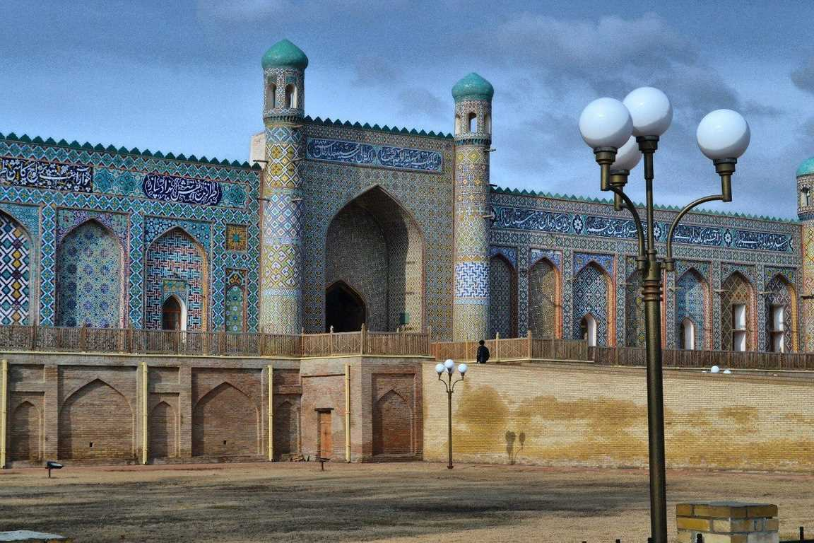
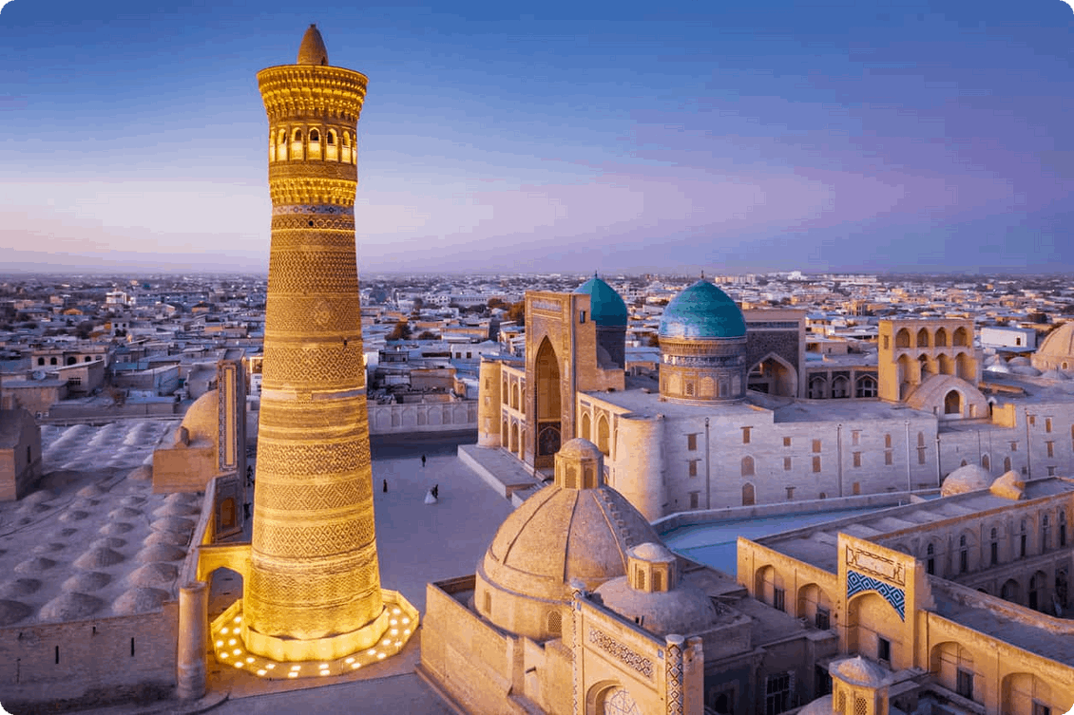
Cities in Uzbekistan
KOKAND
BUKHARA

Slide 19






Food in Uzbekistan

Slide 20
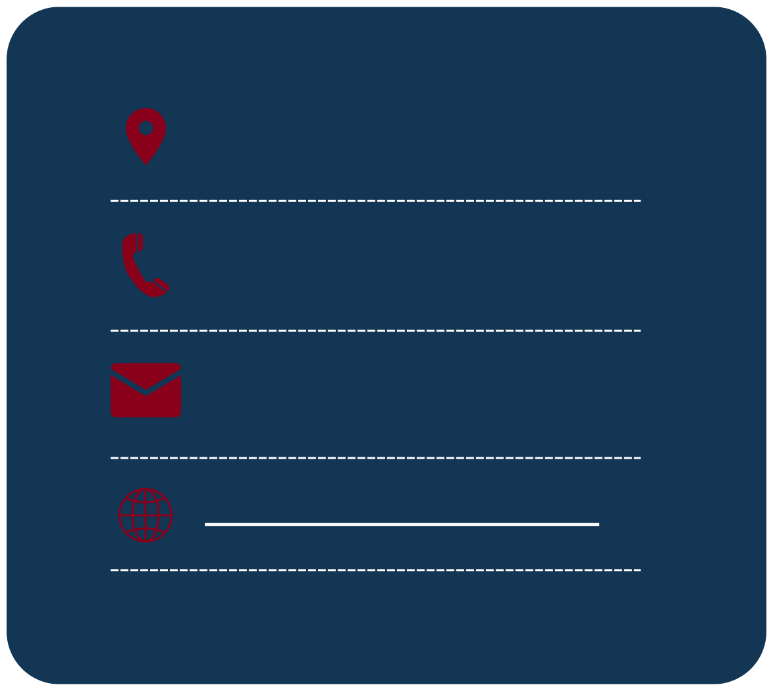



UWED Contacts
54 Mustakillik Ave., Tashkent 100007, Uzbekistan
International Academic Cooperation Office
+998712676769
+998712670706 (ext. 195)
rektorat@uwed.uz
international@uwed.uz
https://www.uwed.uz/en
uwed_official
uwed_official

